Slide 1
Learning Deep Models for Face Anti-Spooﬁng: Binary or Auxiliary Supervision
(In CVPR 2018)
朴智新
2018年6月29日

Slide 2
What is Face Anti-Spooﬁng?

Slide 3
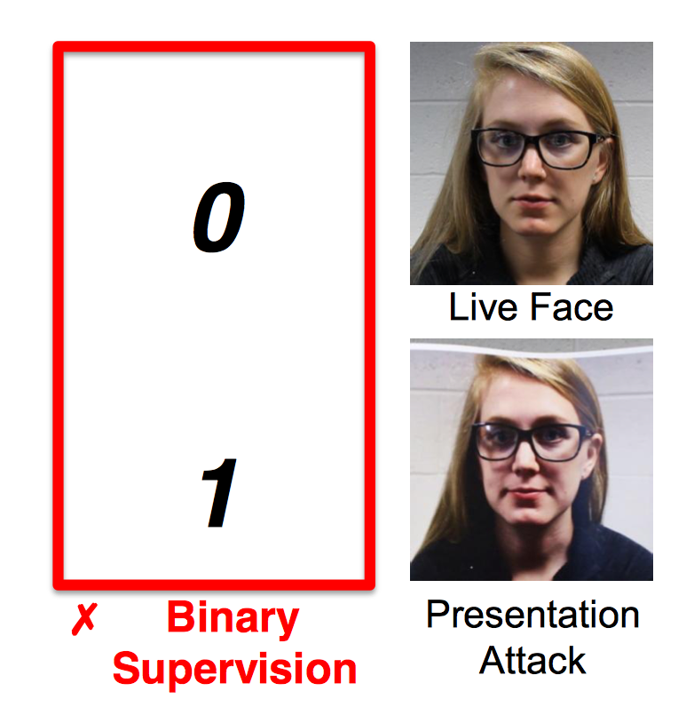
INTRODUCTION
What is presentation attacks?
While face recognition systems gain popularity, attackers present face spoofs (i.e., presentation attacks, PA) to the system and attempt to be authenticated as the genuine user. The face PA include printing a face on paper (print attack), replaying a face video on a digital device (replay attack), wearing a mask (mask attack), etc.
What is Face Anti-Spooﬁng?
To counteract PA, face anti-spooﬁng techniques are developed to detect PA prior to a face image being recognized.

Slide 4
Why is it challenging and/or haven't been solved?

Slide 5
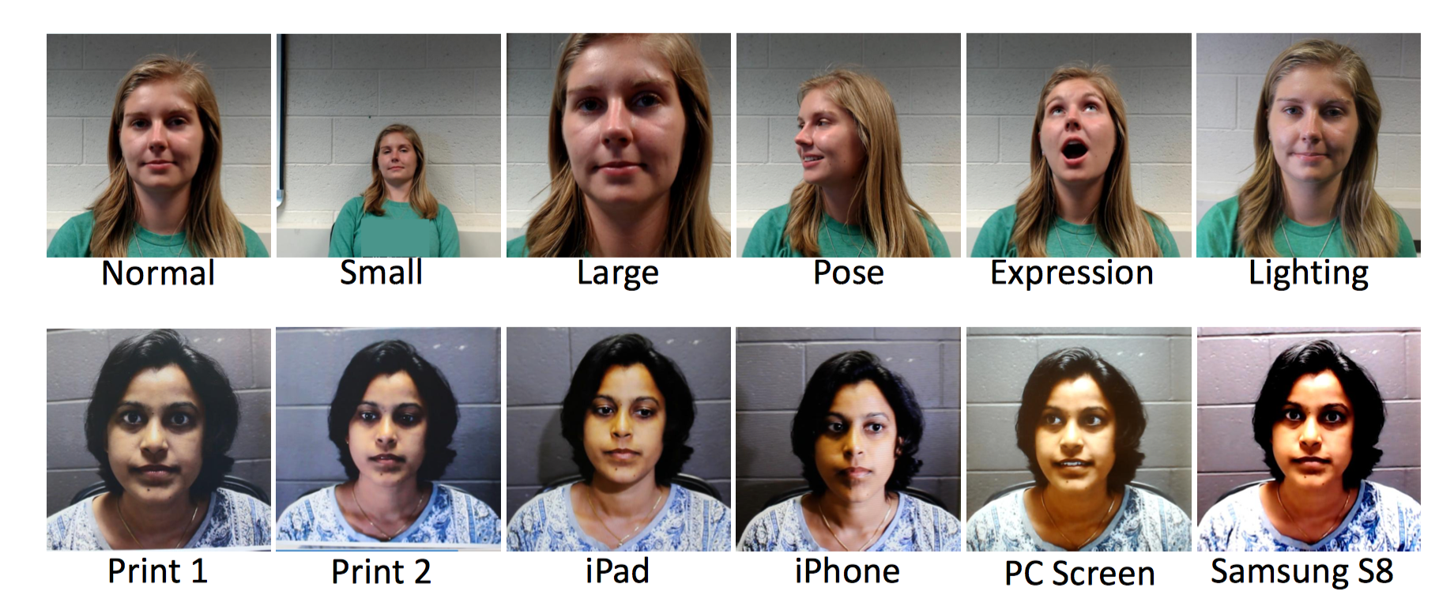
CHALLENGE
different levels of image degradation
Example live (top) and spoof (bottom) videos in SiW
only generate a binary decision without explanation or rationale

Slide 6
Main idea and Methodology

Slide 7
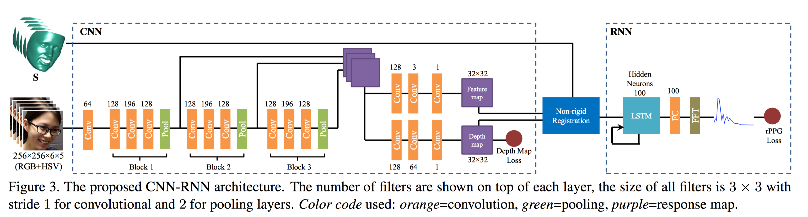
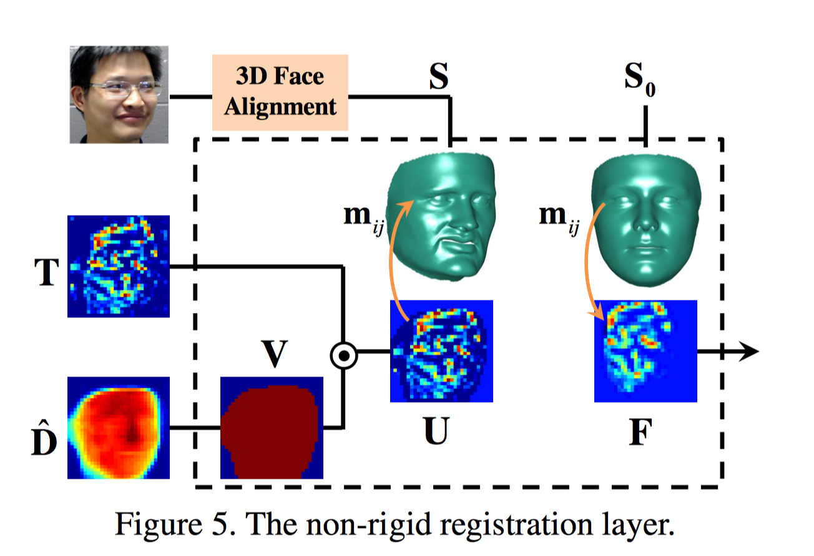
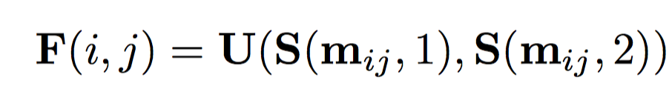
OVERVIEW

Slide 8
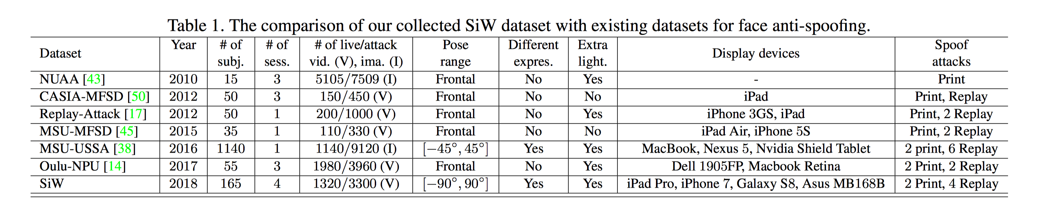
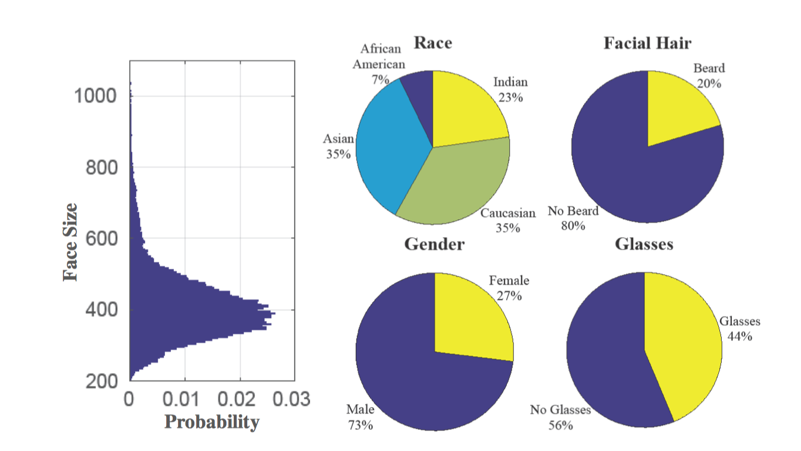
SiW DataSet

Slide 9
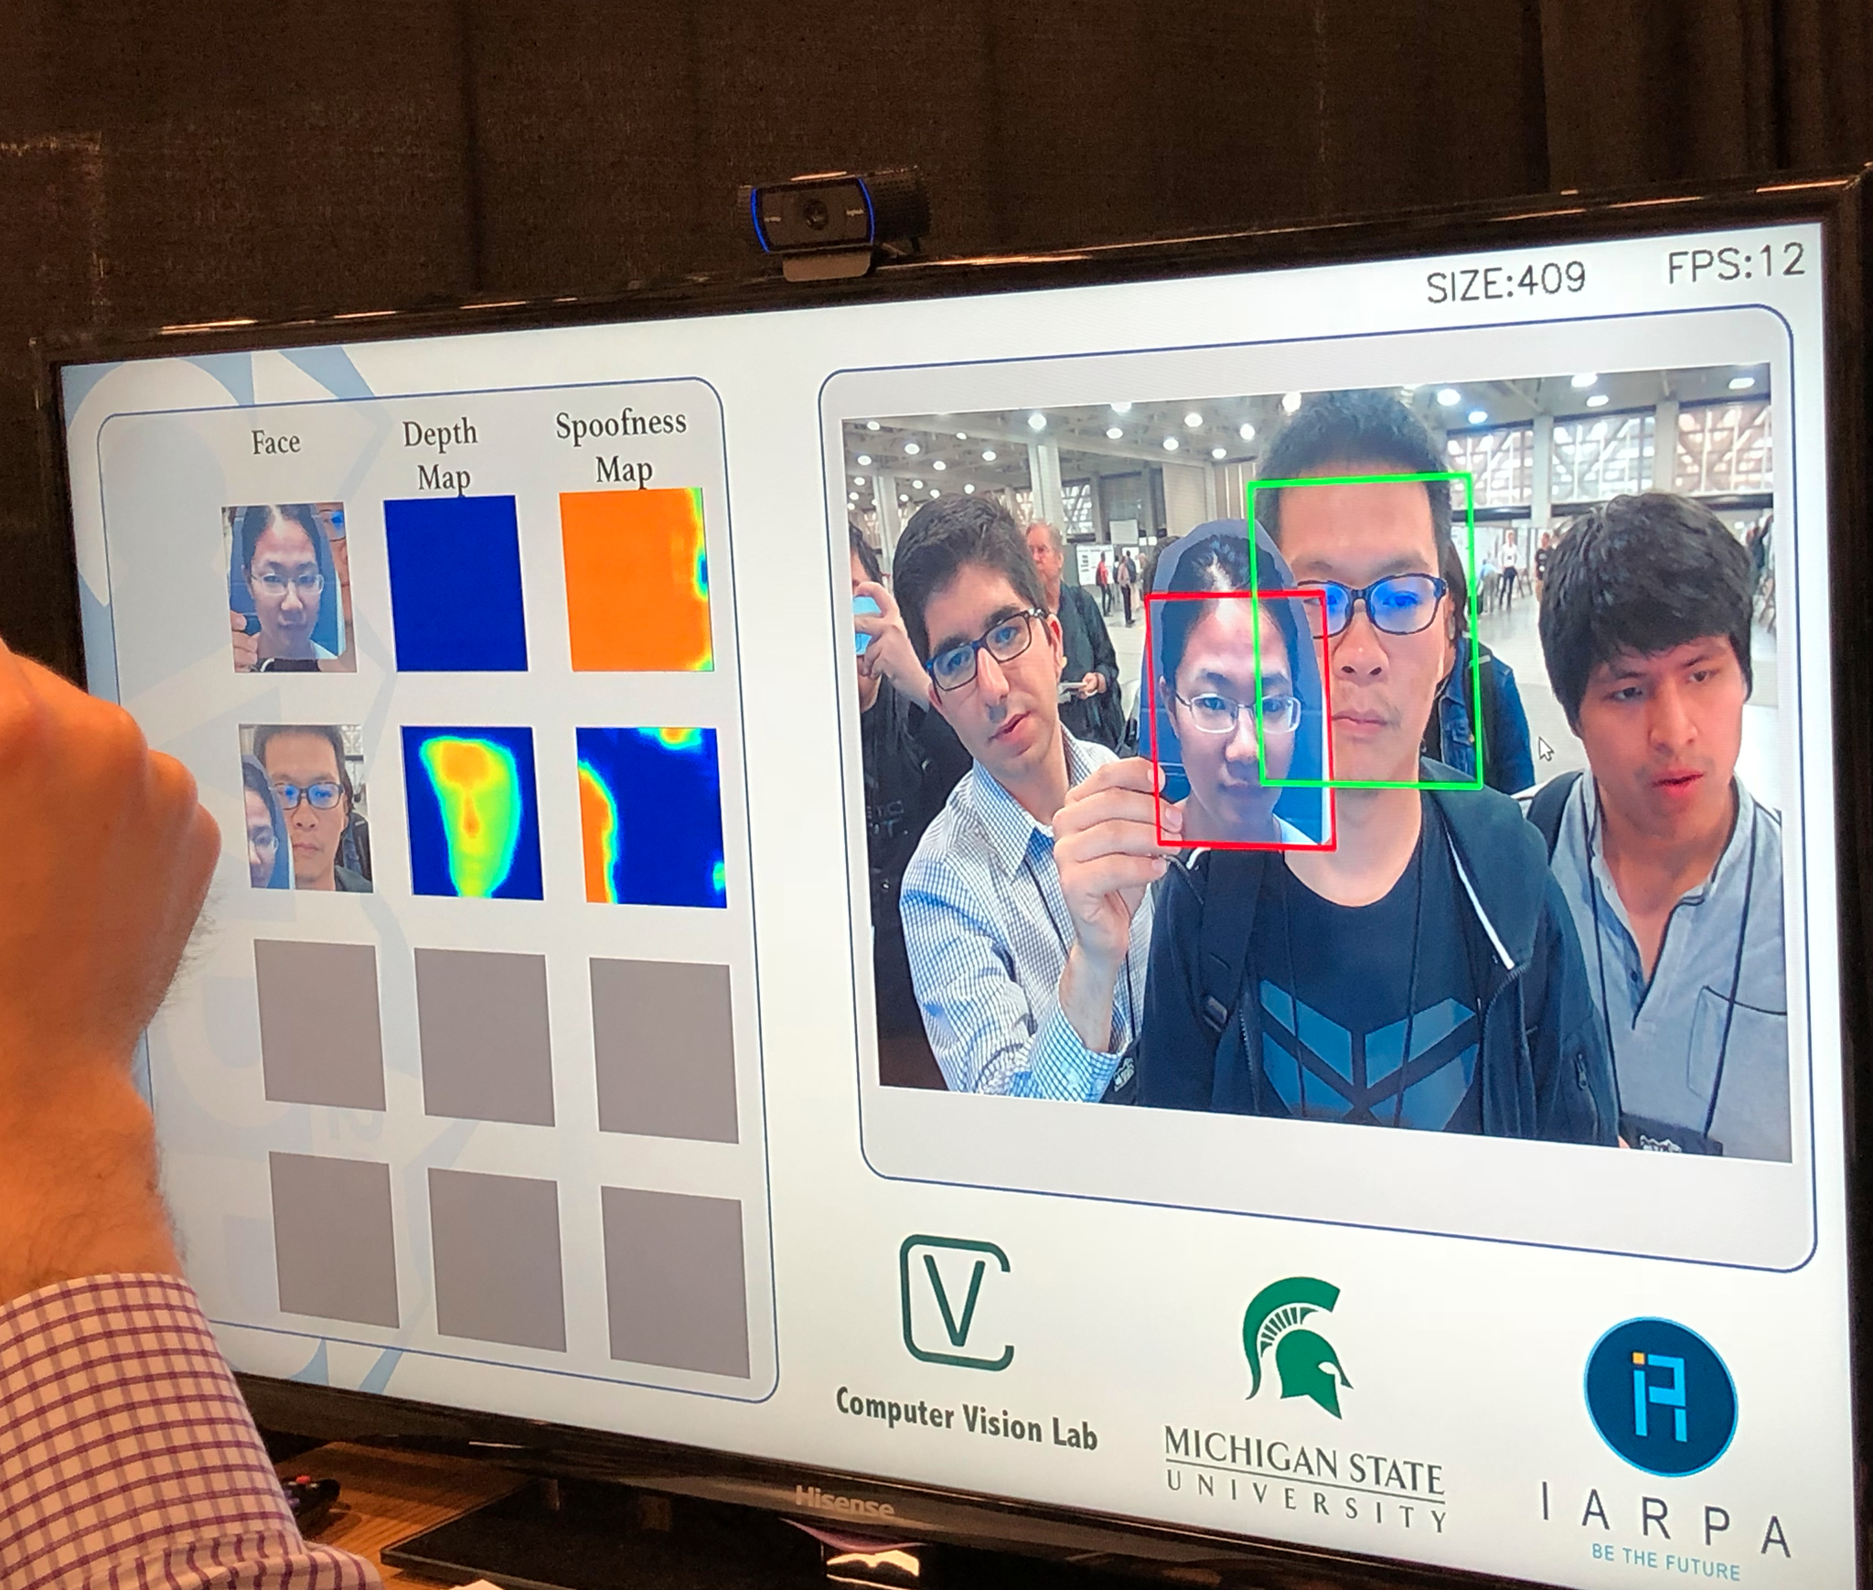
Demo

Slide 10
CONTRIBUTION
We propose to leverage novel auxiliary information (i.e., depth map and rPPG) to supervise the CNN learning for improved generalization.
We propose a novel CNN-RNN architecture for endto-end learning the depth map and rPPG signal.
We release a new database that contains variations of PIE, and other practical factors. We achieve the state-of-the-art performance for face anti-spooﬁng.

